Slide 1
Implementation of CNNs using TensorFlow and PyTorch
Dr. Meghna Kapoor

Slide 2
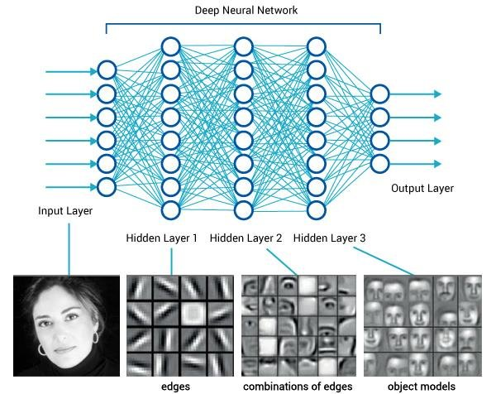
Motivation
Why convolutional models dominate modern computer vision
Role of deep learning libraries in enabling fast prototyping
Practical goal for today: build and train a simple CNN in both frameworks

Slide 3
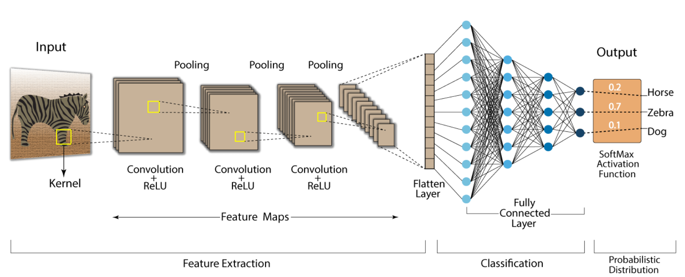
What is a Convolutional Neural Network?
A neural architecture designed for image data
Learns spatial patterns using local receptive fields
Composed of convolution, activation, pooling and fully connected layers

Slide 4
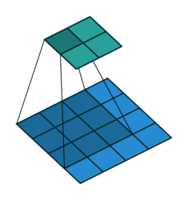
Core CNN Operations
Convolution: learnable filters scanning across the image

Slide 5
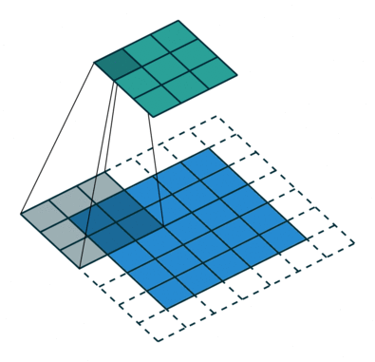
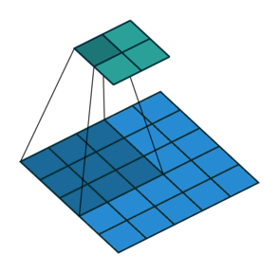
Core CNN Operations
Stride & Padding: control spatial resolution

Slide 6
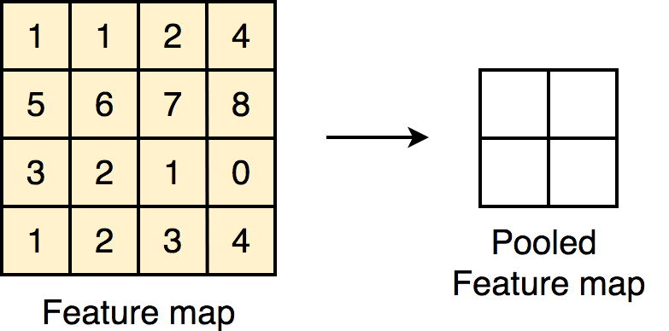
Core CNN Operations
Pooling: downsampling to reduce dimension and increase invariance

Slide 7
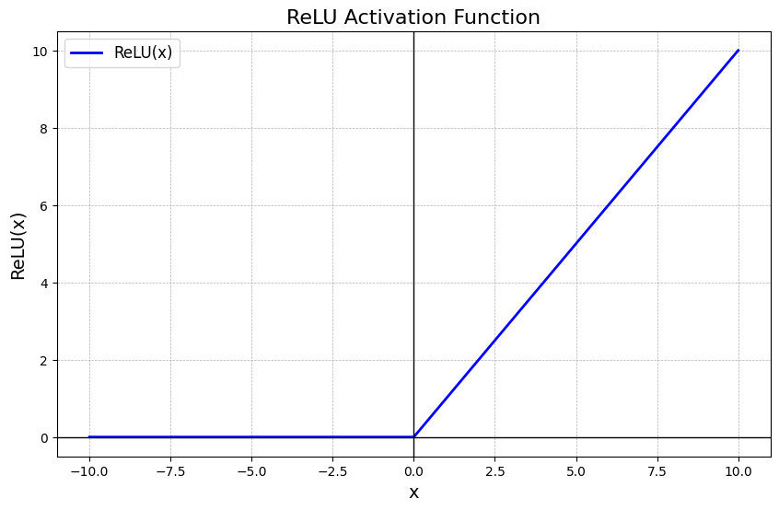
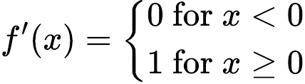
Core CNN Operations
ReLU: introduces non-linearity

Slide 8
Typical CNN Architecture
Conv → ReLU → Pool → Conv → ReLU → Pool → Flatten → Dense
Feature extraction stack
Classifier head

Slide 9
Introduction to Frameworks
• Industry and research standard
• GPU acceleration
• Direct support for CNNs, datasets and training utilities

Slide 10
TensorFlow Basics
• Uses eager execution and Keras high-level API
• Model building via Sequential or subclassed models
• Strong ecosystem (TF Hub, TF Data, TensorBoard)

Slide 11
TF Hub (TensorFlow Hub)
TensorFlow Hub is a library for reusable pretrained models.
What it does:
Lets you download and use models trained by experts
Commonly used for transfer learning
Works for text, images, audio, and more
Example use cases:
Using a pretrained image feature extractor instead of training from scratch

Slide 12
TF Data (tf.data)
TF Data is an API for efficient data loading and preprocessing.
What it does:
Handles large datasets that do not fit in memory
Builds fast input pipelines
Supports batching, shuffling, caching, and parallel loading

Slide 13
TensorBoard
TensorBoard is a visualization and monitoring tool.
What it does:
Shows training metrics like loss and accuracy
Visualizes model graphs
Displays histograms of weights and gradients
Helps compare multiple training runs
Common things you view:
Learning curves
Overfitting vs underfitting
Model structure

Slide 14
PyTorch Basics
• Dynamic computation graph
• Model building through nn.Module
• Widely used in research due to flexibility

Slide 15
What We Will Implement Today
• Build a simple CNN in TensorFlow
• Build a simple CNN in PyTorch
• Train on MNIST dataset
• Compare accuracy and workflow

